Slide 1

Video suggestion and discovery for youtube: taking random walks through the view graph.
Written by: Baluja et al. (2008)
Google.com & University of Pittsburgh
Presented by: Omer Bar-Ness
Citation count: 352

Slide 2
Youtube Facts:
Launched in 2005
800 million unique users a month (2014)
300 hours of new videos were uploaded every minute (2014)
YouTube consumed as much bandwidth in 2007 as the entire Internet in 2000

Slide 3
Video suggestion algorithm
What should we demand from such an algorithm?
Incremental computation
Random
Scalability
Fast

Slide 4
Why should we recommend videos?
Vast video repository: ~45 million (2008)
~7 hours of video uploaded every minute
Difficult to find new videos

Slide 5

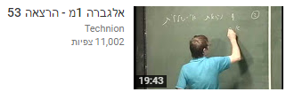
What should we suggest?

Slide 6
Solution – “Adsorption” Algorithm
The Video Co-View Graph
The Adsorption Algorithm
Experimental Setup
Empirical results
Conclusions

Slide 7
The Video Co-View Graph
Co-view Numbers:
For any pair of videos, the number of people who viewed both
How should we encode this data into a useful graph?

Slide 8
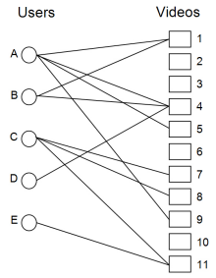
User-Video Graph
Helps us compute the co-view number for each pair of videos.
Each Path of length two from Video i to video j, adds one to the co-view number.

Slide 9
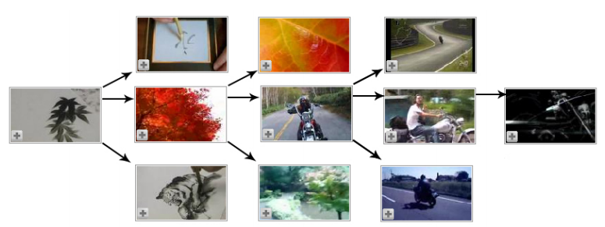
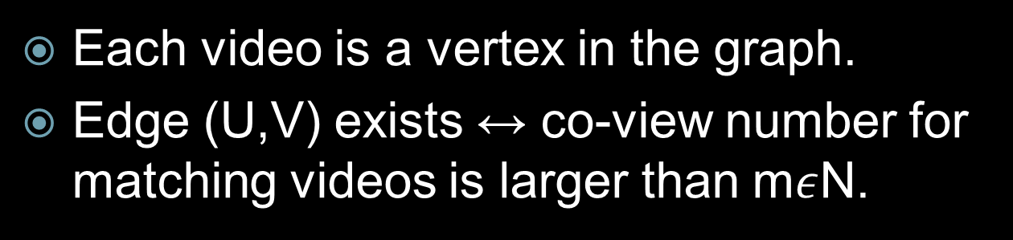
Video-Video Co-View Graph
Each video is a vertex in the graph.
Edge (U,V) exists ↔ co-view number for matching videos is larger than m$ε$N.

Slide 10
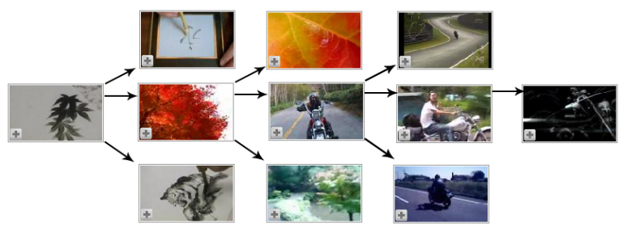
Video-Video Co-View Graph
Our first video is about Sumi drawing

Slide 11
Video-Video Co-View Graph
Next set of videos, are related to Sumi drawing.

Slide 12
Video-Video Co-View Graph
Red leaf video, is connected with a video that relates to nature as well.

Slide 13
Video-Video Co-View Graph
That video, leads us to videos purely about motorcycles.

Slide 14
Co-view data - usage
We’ve computed the co-view data.
How can we use the data to recommend videos?

Slide 15

L
Union{L,M,N,O,P,Q}
Co-views
Times video suggested
Total views
Any combination of above heuristics
w_{i}
M
w_{i}
J
w_{i}
N
w_{i}
K
w_{i}
O
w_{i}
w_{i}
P
Q

Slide 16
Solution – “Adsorption” Algorithm
The Video Co-View Graph
The Adsorption Algorithm
Experimental Setup
Empirical results
Conclusions

Slide 17
The Adsorption Algorithm
Introduction
Adsorption via averaging
Adsorption via random walks
Adsorption via linear systems
Injection and dummy probabilities

Slide 18
Adsorption - introduction
Label propagation
This algorithm is used in order to propagate labels from some node in a graph to other nodes in the graph.

Slide 19
Adsorption - introduction
Label propagation
Label₁
Label₂
Label_{j}
Label₁
Label_{j+1}
Label_{k}
a
b
Label_{j+3}
Label_{k}
Label_{m}
c

Slide 20
Adsorption - introduction
Label propagation
Label₁
Label₂
Label_{j}
Label₂
Label₁
Label_{j+1}
Label_{k}
a
b
Label_{j+3}
Label_{k}
Label_{m}
c

Slide 21
Adsorption - introduction
Label propagation
Label₁
Label₂
Label_{j}
Label₁
Label_{j+1}
Label_{k}
Label₂
a
b
Label_{j+3}
Label_{k}
Label_{m}
c

Slide 22
Adsorption - introduction
Label propagation
_{0.33}
_{0.33}
_{0.33}
Label₁
Label₂
Label_{j}
Label₁
Label_{j+1}
Label_{k}
Label₂
0.25
0.25
0.25
0.25
Label₁
a
b
Label_{j+3}
Label_{k}
Label_{m}
_{0.33}
_{0.33}
_{0.33}
c

Slide 23
Adsorption - introduction
Label propagation
_{0.33}
_{0.33}
_{0.33}
Label₁
Label₂
Label_{j}
Label₁
Label_{j+1}
Label_{k}
Label₂
0.4
0.2
0.2
0.2
a
b
Label_{j+3}
Label_{k}
Label_{m}
_{0.33}
_{0.33}
_{0.33}
c

Slide 24
Adsorption - introduction
Several ways to propagate labels:
Shortest distance
Commute time
Electrical resistance
Very expensive to compute!
Do not admit to incremental updates.

Slide 25
Adsorption - introduction
Assume user a user has watched video v
What relations between videos v and u will imply a high correlation between the two?

Slide 26
Adsorption - introduction
Short path
Can point on some correlation between two nodes
Any drawbacks?
דוד צילג – אלגברה לינארית 1 הרצאה 47
Gangnam style
Korean music awards

Slide 27
Adsorption - introduction
Several paths
Can indicate a stronger correlation between two nodes
Any drawbacks?

Slide 28
20k
5k
10k
110k
8k
758M
14k
412k
1k
0.5k
What is the problem?

Slide 29
Adsorption - introduction
Avoid high-degree nodes!
By avoiding high degree nodes – we eliminate multiple unwanted paths between unrelated nodes.

Slide 30
Adsorption - introduction
Those three heuristics will guide us in the creation of the algorithm
Short path between any videos
Several paths between any videos
Avoid High-degree nodes

Slide 31
Adsorption - introduction
This algorithm focuses solely on the propagation of labels.
Given a Label distribution on each node in the graph, we already have a video suggesting algorithm.

Slide 32
The Adsorption Algorithm
Introduction
Adsorption via averaging
Adsorption via random walks
Adsorption via linear systems
Injection and dummy probabilities

Slide 33
Adsorption via averaging
In the beginning of the algorithm some nodes carry labels.
Each node has two responsibilities, forwarding labels and collecting labels.
Each node will keep full information of labels it received

Slide 34
Adsorption via averaging
Graph G=(V,E,w)
L – a set of labels
V_{L} – a set of labeled nodes
L_{V} – the probability distribution v has on L

Slide 35
Adsorption via averaging
Pre processing – for each vertex v, we create a “shadow” vertex ṽ
ṽ will only have one out - neighbor - v
w(ṽ,v) = 1
We now move the label distribution L_{V} from v to ṽ.
We leave the label distribution L_{v} for each v empty

Slide 36
Adsorption via averaging
v
150
u
120
w
Label₁
Label₂
Label₁
Label₂
Label₁
Label₂

Slide 37
Adsorption via averaging
U’
V’
w'
1
1
1
v
150
u
120
w
Label₁
Label₂
Label₁
Label₂
Label₁
Label₂

Slide 38
Adsorption via averaging
Label₁
Label₂
Label₁
Label₂
Label₁
Label₂
U’
V’
w'
1
1
1
v
150
u
120
w

Slide 39
Adsorption via averaging
Input: G = (V, E, w), L, V_{L}.
repeat
for each v ∈ V ∪ Ṽ
Let L_{v} = ∑_{U} w(u, v)L_{u}
end-for
Normalize L_{v} to have unit L₁ norm
until convergence
Output: Distributions {L_{v} | v ∈ V }

Slide 40
The Adsorption Algorithm
Introduction
Adsorption via averaging
Adsorption via random walks
Adsorption via linear systems
Injection and dummy probabilities

Slide 41
Adsorption via random walks
N_{v} (u) = w(u,v) / ∑_{U} w(u, v)
Let us pick a random neighbor u of v, according to N_{v} , and sample a label l according to L_{u}.
Note that:
L_{v} = ∑_{U} N_{v} (u) L_{u}

Slide 42
Adsorption via random walks
Given a vertex v, we take random backwards walks from v. until we reach an absorbing state
If our random walk reached a shadow vertex ṽ the walk stops, since ṽ has no in -neighbors.

Slide 43
Adsorption via random walks
Input: G = (V, E, w), L, V_{L}, vertex v.
done := false
vertex := v
while (not done)
vertex := pick-neighbor(v, E, w)
if (neighbor ∈ ṽ)
done := true
end-while
u := vertex
Output label according to L_{u}.

Slide 44
Adsorption via averaging
Label₃
Label₄
Label₁
Label₂
Label₅
Label₆
U’
V’
w'
1
1
1
v
150
u
120
w

Slide 45
Adsorption via averaging
Label₃
Label₄
Label₁
Label₂
Label₅
Label₆
U’
V’
w'
1
1
1
v
150
u
120
w

Slide 46
Adsorption via averaging
Label₃
Label₄
Label₁
Label₂
Label₅
Label₆
U’
V’
w'
1
1
1
v
150
u
120
w
Absorbing state!

Slide 47
Adsorption via averaging
Label₃
Label₄
Label₁
Label₂
Label₅
Label₆
U’
V’
w'
1
1
1
v
150
u
120
w
Label₃
Label₄

Slide 48
Adsorption via averaging
Label₃
Label₄
Label₁
Label₂
Label₅
Label₆
U’
V’
w'
1
1
1
v
150
u
120
w
Label₃
Label₄

Slide 49
Adsorption via averaging
Label₃
Label₄
Label₁
Label₂
Label₅
Label₆
U’
V’
w'
1
1
1
v
150
u
120
w
Label₃
Label₄

Slide 50
Adsorption via averaging
Label₃
Label₄
Label₁
Label₂
Label₅
Label₆
U’
V’
w'
1
1
1
v
150
u
120
w
Label₃
Label₄
Absorbing state!

Slide 51
Adsorption via averaging
Label₃
Label₄
Label₁
Label₂
Label₅
Label₆
U’
V’
w'
1
1
1
v
150
u
120
w
Label₃
Label₄
Label₅
Label₆

Slide 52
Adsorption via random walks
This algorithm needs to be repeated several times for each vertex v.
Therefore, it is very expensive to compute.
The algorithm is equivalent to the algorithm in section 2.1 (adsorption via averaging), which has a very efficient implementation.

Slide 53
Adsorption via random walks
Typical random walk
The probability that the walk visits some node, Is fixed. And does not depend on the node we began our walk from.

Slide 54
Adsorption via random walks
Adsorption random walk
The node we begin the walk from, is crucial in determine the probability of reaching a specific node. This is allowed thanks to the presence of “absorbing” nodes.
Any change we make on those “absorbing” nodes, will have an impact on our walk.

Slide 55
The Adsorption Algorithm
Introduction
Adsorption via averaging
Adsorption via random walks
Adsorption via linear systems
Injection and dummy probabilities

Slide 56
Adsorption via linear systems
Each distribution L_{v} is a combination of L_{u}’s for some vertexes u₁ u₂ … u_{n} .
Each node in the graph can be represented as a combination of the other nodes.
This can provide us an embedding of all vertexes into L₁.

Slide 57
Adsorption via linear systems
We can now solve our problem, by solving a Linear system
It is proved that the LS has a solution, if and only if the graph is connected.

Slide 58
Adsorption via linear systems
Input: G = (V, E, w)
Let n := |V|
Define the linear system of equations in n² variables:
X_{uv}, for u, v ∈ V
∑_{v} X_{uv} = 1 , f.e u ∈ V
∑_{z:(z,u) ∈ E} w(z,u)X_{zv} = X_{uv} f.e u,v ∈ V

Slide 59
Adsorption via linear systems
We can set a parameter t, which determines the maximum distance between any two vertices
For each vertices u , v
if distance(u,v)>t
Than X_{uv} = 0.
This will reduce the number of equations, and will allow a faster solution of the linear system.

Slide 60
The Adsorption Algorithm
Main Theorem – All three adsorption algorithms are equivalent

Slide 61
The Adsorption Algorithm
Introduction
Adsorption via averaging
Adsorption via random walks
Adsorption via linear systems
Injection and dummy probabilities

Slide 62
Injection and dummy probabilities
We saw on section 2.2 (adsorption – RW) that each vertex ṽ is an absorbing vertex.
Thus, it brings our random walk to an end.
In the pre processing step, we have set w(v, ṽ) = 1.
By changing the weight on that edge, we can have a very strong influence regarding when our walk would end.

Slide 63
Injection and dummy probabilities
We relate to the computation of w(v, ṽ) as an injection to the algorithm
Different injections, can produce very different results. We should use those injections in order to maximize our results

Slide 64
Injection and dummy probabilities
In addition, we can add dummy labels to some of the videos.
Those dummy labels, with very high probability, will bring our walk to an end.
If a one of the nodes, represents a very popular video, we would want our walk to stop, Since the probability of the algorithm offering a non related video, arises significantly.

Slide 65
Solution – “Adsorption” Algorithm
The Video Co-View Graph
The Adsorption Algorithm
Experimental Setup
Empirical results
Conclusions

Slide 66
Experimental setup
We now have an algorithm that allegedly recommends users with videos they would like to watch.
One of the main challenges of video recommendation algorithms, is measuring they’re success.
A good experimental setup for measuring the algorithm, is not trivial.

Slide 67
Experimental setup
One good solution may be testing the algorithm lively.
If the algorithm isn’t good , this can have a very bad impact on the website.

Slide 68
Experimental setup
Data collected through 92 days.
5.4 million users, from a specific geographical area.
A video was only collected, if user viewed 33% of its content.
Result – total of 29 million views, spread over 4.2 million videos.

Slide 69
Experimental setup
Data was partitioned into two sets
Training set (days 1-46)
Test set – (days 47-92)
The training set was used In order to let the algorithm collect data and analyze it.
The test set was used in order to recommend videos to users using our algorithm, and evaluate success rate

Slide 70
Experimental setup
A recommendation of video v to a user, was counted successful, if user hasn’t watched video v during the training period, but watched after it’s been offered on the test period.

Slide 71
Experimental setup
Users which only had views in one of the sets –were discarded.
Videos who only appeared in one of the sets were also discarded.
Result:
1.1 million users (5.4)
1.3 million videos (4.2)
12.5 million watches (29)

Slide 72
Experimental setup
W₁ – videos watched by user during training period
W – videos watched by user during test period
R – ranked list of recommended videos per user
R_{t} – top t ∈ N, videos recommended per user
Measures:
Precision_{t} (W,R) = |W Ո R_{t}| / |R_{t} |
Recall_{t} (W,R) = |W Ո R_{t}| / |W |

Slide 73
Experimental setup
Algorithms tested:
GP – General Popularity. Recommends videos only by their popularity

Slide 74
Experimental setup
Algorithms tested:
LP – Local Popularity – a variation of GP, that takes co-views into account.

Slide 75
Experimental setup
Algorithms tested:
Adsorption-N – does not allow dummy nodes.
Adsorption-D –allows dummy nodes.
Both were implemented using the averaging version of adsorption. Until set of recommendations has largley converged.

Slide 76
Solution – “Adsorption” Algorithm
The Video Co-View Graph
The Adsorption Algorithm
Experimental Setup
Empirical results
Conclusions

Slide 77
Empirical results
All four algorithms were ran on the training set, and recommended a list of 100 recommendations. R₁₀₀
Algorithms were only allowed to recommend a user with a video he hasn’t watched during the training set.

Slide 78
Empirical results
Reminder:
Precision_{t} (W,R) = |W Ո R_{t}| / |R_{t} |
Recall_{t} (W,R) = |W Ո R_{t}| / |W |

Slide 79
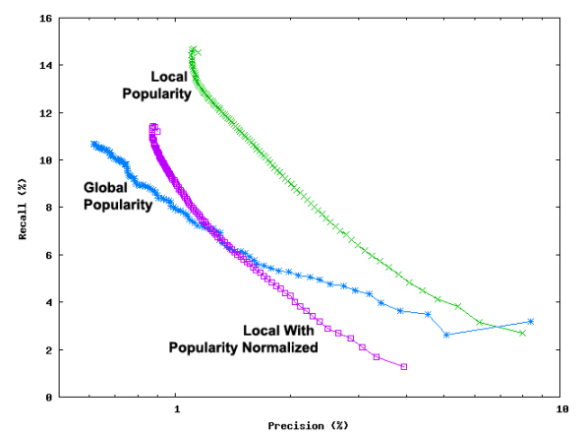
Empirical results

Slide 80
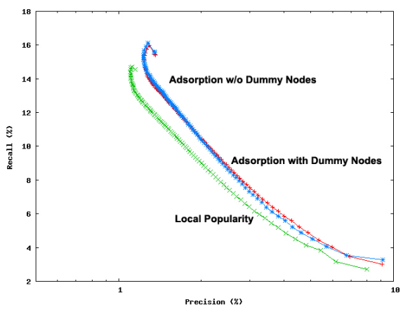
Empirical results

Slide 81
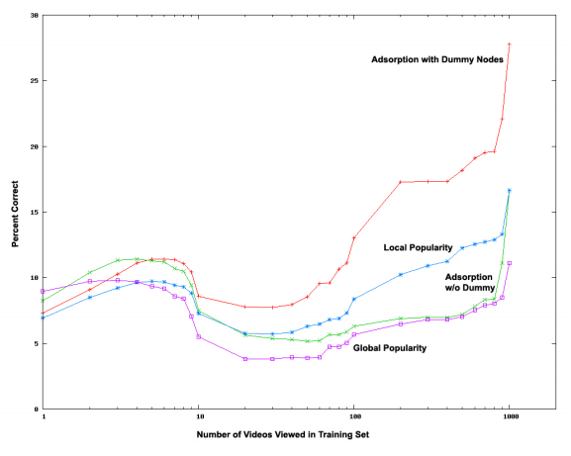
Empirical results

Slide 82
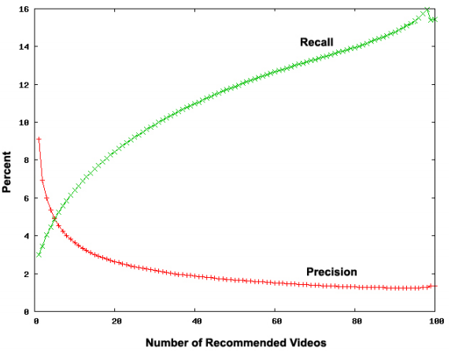
Empirical results
Adsorption - D

Slide 83
Solution – “Adsorption” Algorithm
The Video Co-View Graph
The Adsorption Algorithm
Experimental Setup
Empirical results
Conclusions

Slide 84
Conclusions
Adsorption has proved to be effective in video recommendations.
This method should also prove itself useful for Advertiser targeting, product recommendations, labeling web-imaged, etc.

Slide 85
Thank you

